Slide 1
HHV6 Virus

Slide 2
HHV-6 History and brief overview
1986 first discovered
Found to be the cause of roseola AKA sixth disease in 1988 (sudden high fever for a few days followed by a rash) – very common, mild, affects most kids by 2 years old or kindergarten https://www.mayoclinic.org/diseases-conditions/roseola/symptoms-causes/syc-20377283
Most have antibodies for it by school age, making them immune to a second infection; if affected later in life it is usually mild, but it could be very harmful to people with compromised immune systems, such as organ transplant recipients
No vaccine for it
Typically transferred by saliva

Slide 3
More about HHV-6 incidence
HHV6 and HHV7: Persistence and vertical transmission https://www.jpeds.com/article/S0022-3476(04)00658-4/fulltext
  Acquired early in childhood; found in nearly 100% of all children by 2 years old
  Accounts for 10% and 20% of ER visits related to fever for children under 3 and 6-12 months old, respectively
  Can hang out in bone marrow inactive

Slide 4
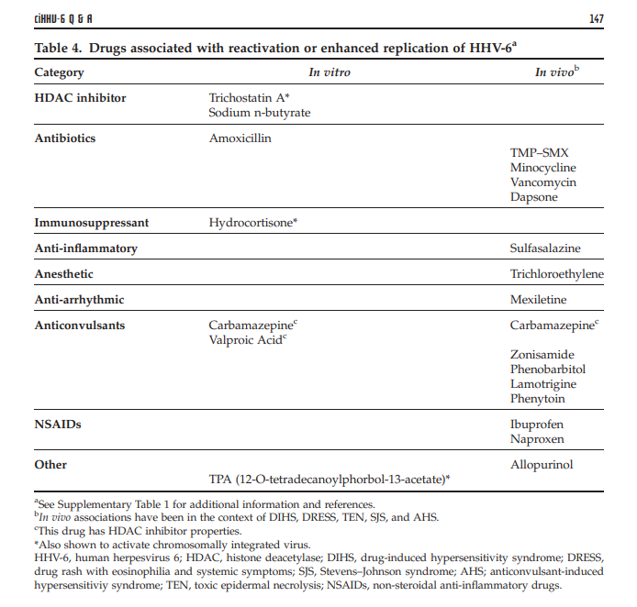
Medications that may worsen infection…
Chromosomally integrated human herpesvirus 6: questions and answers → → →
https://www.ncbi.nlm.nih.gov/pmc/articles/PMC3498727/pdf/rmv0022-0144.pdf
HDAC inhibitors (mood stabilizers, antiepileptics)
Antibiotics – amoxicillin
Immunosuppressant – hydrocortisone
Sulfasalazine
Anesthetic
Anticonvulsants
NSAIDS
Allopurinol (used to treat gout or kidney stones and to decrease uric acid in people with cancer)

Slide 5
Who is at risk?
Immunocompromised, such as in organ transplants
  Symptomatic Generalized Epilepsy After HHV6 Posttransplant Acute Limbic Encephalitis in Children https://pubmed.ncbi.nlm.nih.gov/22554258-symptomatic-generalized-epilepsy-after-hhv6-posttransplant-acute-limbic-encephalitis-in-children/?from_term=hhv6+autoimmune&from_pos=5

Slide 6
Incidence in cancer
https://hhv-6foundation.org/category/cancer
Ovarian
TNBC
Glioma
Stomach and colon
Misdiagnosis in lymphoma (lymph node biopsies)
Fatigue

Slide 7
Viral Sequences in Human Cancer
https://www.ncbi.nlm.nih.gov/pmc/articles/PMC5828528/pdf/nihms918147.pdf
Five viral families are prevalent in human cancer
  HPV (cervical) 98.8%
  HPV (head and neck)
  Hepatitis B and C in liver cancers
  HPV and BKV (BK Virus) in small subset of bladder cancers
  HHVs in many different cancers
  EBV in ~20% stomach cancers

Slide 8
Human Herpesvirus 6 and Malignancy:
A Review
https://www.ncbi.nlm.nih.gov/pmc/articles/PMC6277865/pdf/fonc-08-00512.pdf
“There is evidence that HHV-6 is present in certain types of cancer; however, detection of the virus within tumor cells is insufficient for assigning a direct role of HHV-6 in tumorigenesis. Findings supportive of a causal role for a virus in cancer include presence of the virus in a large proportion of cases, presence of the virus in most tumor cells, and virus-induced in-vitro cell transformation. HHV-6, if not directly oncogenic, may act as a contributory factor that indirectly enhances tumor cell growth, in some cases by cooperation with other viruses. Another possibility is that HHV-6 may merely be an opportunistic virus that thrives in the immunodeficient tumor microenvironment.”

Slide 9
HHV-6 has been associated with autoimmune disorders
https://hhv-6foundation.org/associated-conditions/hhv-6-and-immune-suppression
Possible Role of Human Herpesvirus 6 as a Trigger of Autoimmune Disease
  https://www.ncbi.nlm.nih.gov/pmc/articles/PMC3825270/pdf/TSWJ2013-867389.pdf
    Connective tissue disorders (including rheumatoid arthritis)
    MS
    Hashimoto’s Thyroiditis
    Sjogren’s syndrome
    Purpura fulminans – thrombotic disorder, coagulation of microvasculature that’s rapidly progressive and leads to skin necrosis
    Severe autoimmune acquired protein S deficiency (clotting disorder)
    Severe and acute autoimmune hepatitis
    Autoimmune hemolytic anemia (where the body destroys the Red Blood Cells more quickly than they're made) and neutropenia
      https://pubmed.ncbi.nlm.nih.gov/20922523-autoimmune-hemolytic-anemia-and-autoimmune-neutropenia-in-a-child-with-erythroblastopenia-of-childhood-tec-caused-by-human-herpesvirus-6-hhv-6/

Slide 10
How to get tested
https://hhv-6foundation.org/patients/hhv-6-testing-for-patients
  PCR DNA test on plasma or serum
  Quantitative tissue biopsy
  Immunohistochemistry (staining of tissue sessions from biopsies)
  IgM test
  Quantitative PCR of whole blood seems best
    LabCorp https://www.labcorp.com/tests/139310/human-herpesvirus-6-hhv-6-quantitation-dna-pcr
  IFA (Indirect Immunofluorescence Assay) IgG test

Slide 11
Chromosomally integrated HHV-6 (ciHHV-6)
Affects 1% of the population in the US and UK https://hhv-6foundation.org/what-is-hhv-6/chromosomally-integrated-hhv-6
The virus DNA is integrated into the person’s telomeres in their chromosomes
Can be inherited from a parent
Can excise itself and activate under circumstances like immune deficiency
Can become activated by chemo drugs – patient in Boston found to have it after Vorinostat administration https://hhv-6foundation.org/cihhv-6/activation-of-cihhv6-due-to-cancer-drug-vorinostat-an-hdac-inhibitor
Where to get testing (need whole blood analysis, which contains cellular material) https://hhv-6foundation.org/clinicians/cihhv-6-testing
May increase likelihood of Graft Versus Host Disease and bacterial infections in organ transplants

Slide 12
If it’s a trigger, how do we address it?
Antivirals - https://hhv-6foundation.org/research/hhv-6-antiviral-drug-resistance
  Conventional – cidofovir, ganciclovir, foscarnet, brincidofovir
    https://www.ncbi.nlm.nih.gov/pmc/articles/PMC3323089/pdf/03-0587.pdf
  Natural - antimalarial drug artesunate
In MS, diet changes
  Gerson Therapy https://gerson.org/gerpress/nima-multiple-sclerosis-gerson-therapy/
  Other diet changes (read in comments also) https://www.furtherfood.com/multiple-sclerosis-treatment/
  Herbs, antiviral foods like garlic, onion, turmeric, ginger, spirulina; eggs, dairy, corn, https://www.medicalmedium.com/blog/herpes-viruses

Slide 13
Questions? ☺

